Slide 1
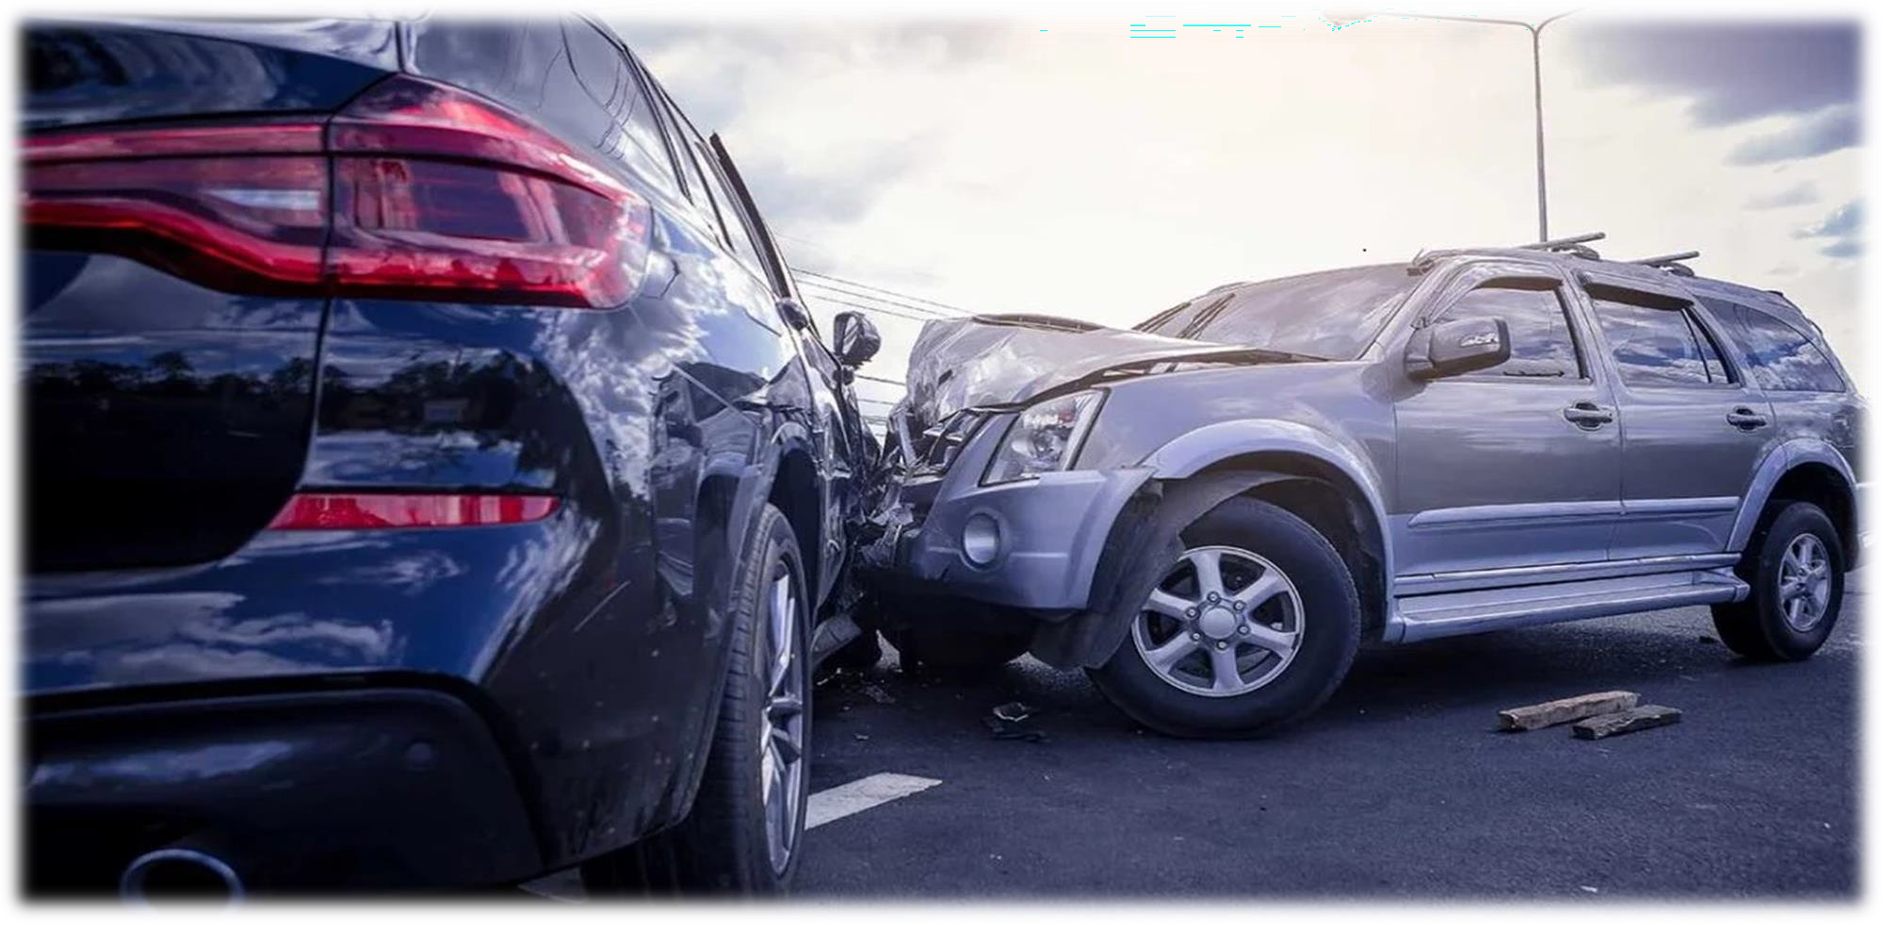
USA Car accidents analysis

Slide 2
Team working on this
Saikumar Jakkula
Data Engineer
Siva linga reddy iska
Team Leader
Yogishwar Reddy Karumulla
Data Engineer
Venkata sai yagna guduguntla
Data Scientist
Siby babu panchakalayil
Data modeling

Slide 3
The Problem
Problem #1
Car accidents hotspot
locations
Problem #2 studying the impact of precipitation or other environmental stimuli
Problem #3
casualty analysis
01
02
03

Slide 4

Statistics
2021
5.2M Road accidents(Expected)
5.2M
4.8M
2020
4.8M Road accidents as per reports
2019
4M Road accidents as per reports
4M

Slide 5
Highlights
Will calculate real-time car accident prediction, studying car accidents hotspot locations, casualty analysis and extracting cause and effect rules to predict car accidents.
plot the graph between severity and weather, temperature and humidity to know the how the severity level depends on weather conditions.

Slide 6
The Solution
Building a model to forecast the locations of hotspots, casualty analysis, the effects of precipitation, and other environmental factors.
01

Slide 7

CRISP-DM
Business Understanding
Deployment
Data understanding
Data
Evaluation
Data Preparation
Modeling

Slide 8








Graphical representation of ETL tools

Slide 9
Technology/expertise
Jupyter Notebook
Data cleaning using Pandas, Numpy
KNN Algorithm
To remove outliers, missing data, identifying the predictive modeling approach and process the data into a suitable model.
MODEL
Model evaluation
We will choose the optimal algorithm based on the accuracy measured using several ML methods.

Slide 10
Technology/expertise
Model Deployment
Flask and Github
MODEL
Data Visualization
Matplotlib, seaborn, PowerBi tool to visualize the data.

Slide 11
Metrics milestones
Milestone #1
To create a Dataset with no null, repeated values.
Milestone #2
Metrics
To obtain Highest accuracy comparatively
Milestone #3
visualizing the data and Finding the hotspot locations.

